Slide 1
Introducing Salita Portfolio Services
December 2025
Presented By
Date
Notes:
​

Slide 2
Disclaimer
© Salita Portfolio Services Pty Ltd 2025. All rights reserved.
Important Information: Salita Portfolio Services Pty Ltd is a corporate authorised representative of Personal Financial Services Ltd AFSL 232706 (“Licensee”). This document has been prepared for general information purposes only and does not take into account the specific objectives, financial situation, legal circumstances, or needs of any individual or organisation. The information contained in this document is not intended to constitute legal, financial, or other professional advice and should not be relied upon as such. Before making any decision or taking any action based on the contents of this report, you should consider its appropriateness to your circumstances and seek independent professional advice. Any references to past performance are provided for illustrative purposes only and are not a reliable indicator of future performance. No representation is made that any outcomes or results will be achieved in the future. To the maximum extent permitted by law, Salita Portfolio Services and the Licensee disclaim all liability for any loss or damage (including indirect or consequential loss) arising from reliance on the information contained in this report or from any error or omission

Slide 3
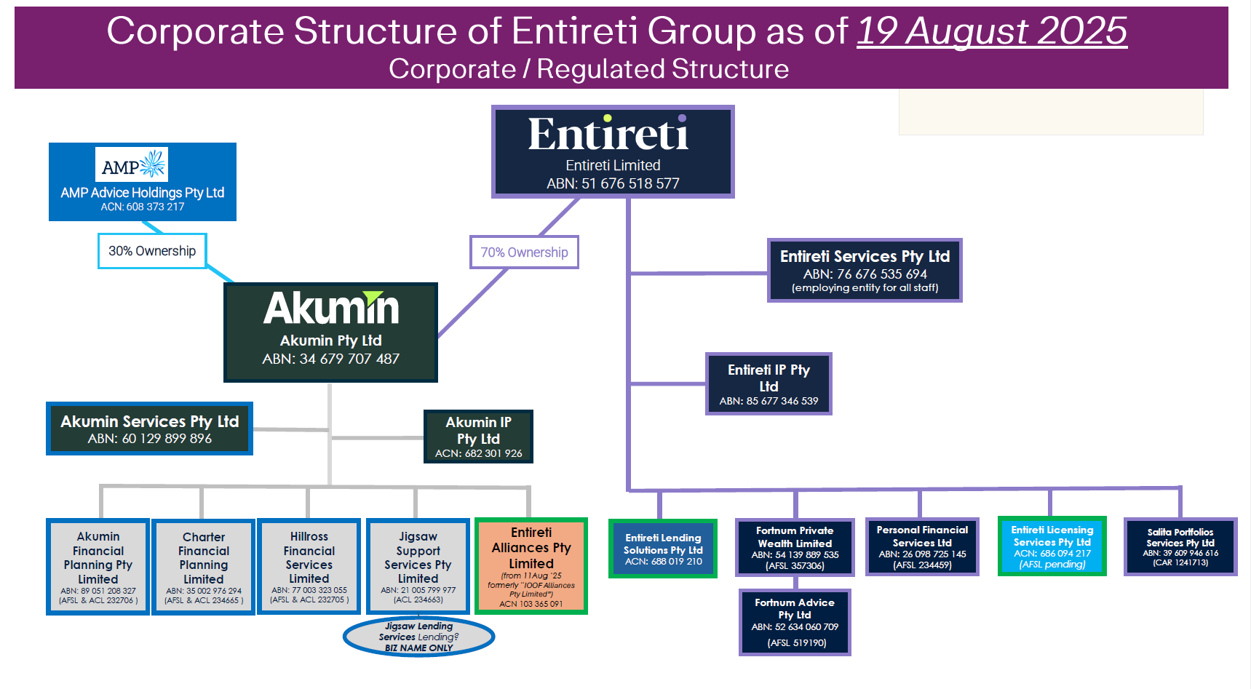

Slide 4
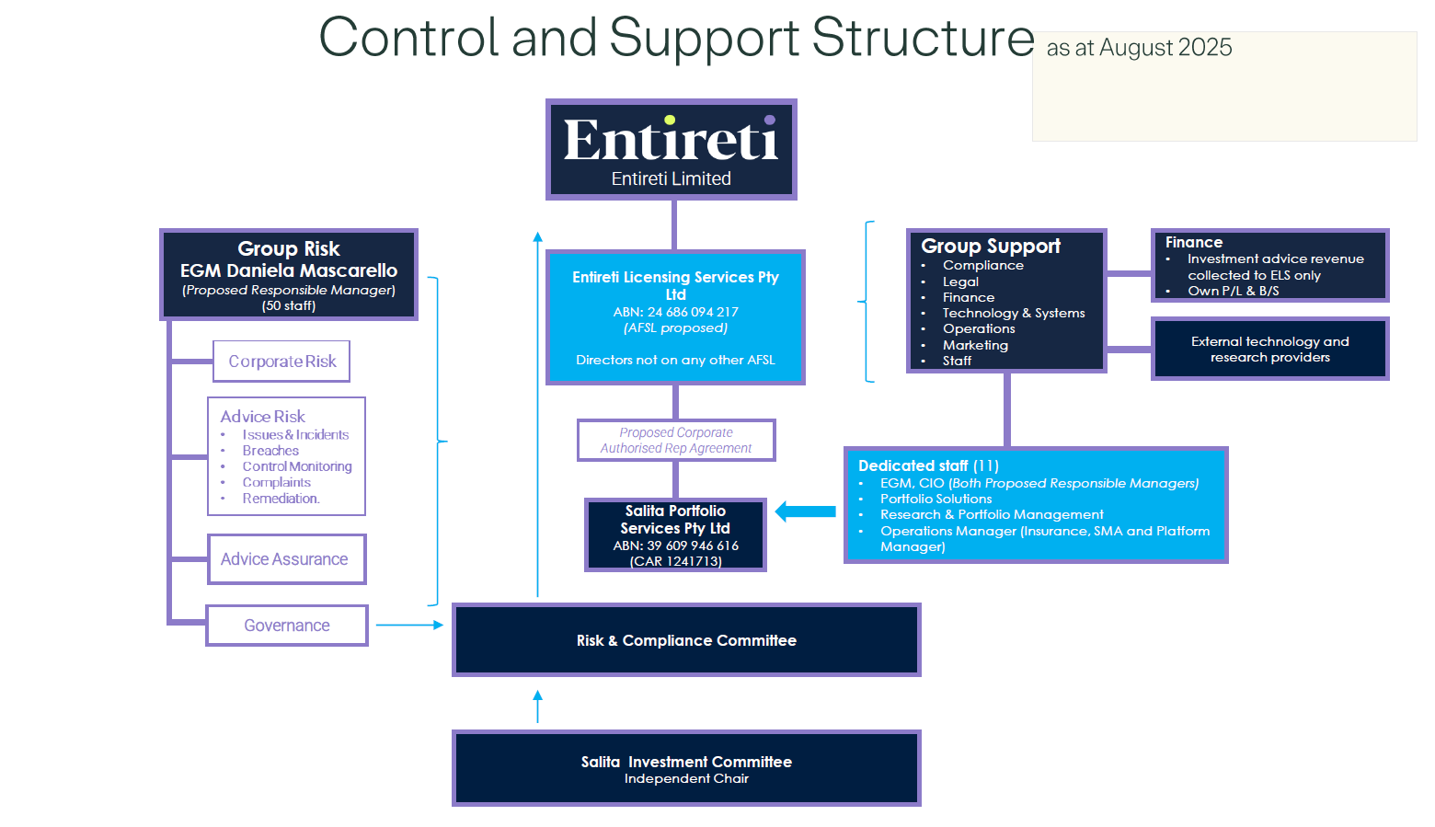

Slide 5

Working harder for your clients
We founded Salita with one purpose — to give our financial advisers a portfolio management partner that truly understands their world.
Backed by Entireti, Salita partners with leading research providers and global investment managers through Lonsec Investment Solutions, together with BlackRock and Franklin Templeton.
Our team averages more than 25 years in the industry, which means we know first-hand the challenges advisers face, and what clients truly need.
Why Salita?
Derived from the word meaning “ascent” or “rise” in several languages, Salita reflects our purpose: to help advisers and their clients’ investments ascend to new heights – in capability, confidence, and outcomes.
It symbolises upward movement, progress, and long-term potential, everything a well-constructed portfolio service should deliver
Whether you’re looking to scale your advice business, deliver better client outcomes, or streamline your investment offering, Salita Portfolio Services is here to elevate your journey.

Slide 6








Part of the Entireti group of services
Diversified services company
Salita is the culmination of experience and now our significant scale, delivered to the largest licensee network in the country.
At Salita, we deliver quality portfolio construction services designed exclusively for financial advisers.
Scale benefits from $150B in group FUM
Est 2016 – previously PFSIM
10+ years managing multi asset portfolios
Managing $5B - managed accounts and investment advisory
Supported by dedicated resources
NEW G-Series (Growth / Defensive)
Better together
Licensee’s
Service offer

Slide 7



What makes Salita different?
It’s simple. Advisers should have a portfolio management solution built entirely around their clients’ unique needs.
Client focused, adviser led.
Always on.
Always accessible.
Value active management.

Slide 8
Our people
02

Slide 9
Our broader team and services
Research and PORTFOLIO SOLUTIONS TEAM
Portfolio solutions
Research services
Portfolio Management
Sarah mCCARTHY
Head of Portfolio Solutions
Sean Webster
Head of Research Services
& Senior Portfolio Manager
Aman RamRAKHA
Chief Investment Officer
Natara evans
Senior Manager, Portfolio Solutions
Julia tao
Senior Investment Research Analyst
TIM schroeders
Senior Portfolio Manager
Calvin yap
Senior Investment Research Analyst
CINDY XIN ZHAO
Manager, Investment Governance
250+ years combined experience
Local & global expertise
Australia’s Largest licensee Research team
Frank mach
Investment Research Analyst
NIGEL DOUGLAS
Independent Chairperson
Investment and IIC Committees
EKTA BADOLA
Investment Research Analyst
CORE SERVICES
CORE SERVICES
CORE SERVICES
Practice engagement Diagnostic consulting framework Investment Philosophy development Navigating choice & comparisons Aligning the right solutions | APL management Investment and insurance queries Non-APL Approvals Portfolio construction support Adviser and client communications | Salita Portfolio Services Portfolio Management & Investment governance Model management HNW & bespoke portfolios CIO Updates

Slide 10
Experienced Team
Our team averages 25+ years in the industry, combining seasoned judgment with adviser-aligned expertise.
Name | Title | Qualification | Years (Industry / Entireti*)
John Carnevale | Exec GM of Research & Investment Services | MFinLaw, GDipAppFinInv, BCom, DipFP, DipSM | 35 / 7
Aman Ramrakha | Chief Investment Officer | BCom, CIMA, ,GDipAppFinInv, DipFinP | 30 / 0.5
Tim Schroeders | Senior Research & Portfolio Manager | Aff SIA | 30 / 7
Sean Webster | Head of Research Services & Portfolio Manager | MArts, CFA, BCom | 29 / 9
Calvin Yap | Investment Research Analyst | CFA, MFin, BCom | 15 / 4
Julia Tao | Investment Research Analyst | CFA, MCom | 18 / 6
Frank Mach | Investment Research Analyst | BBus | 15 / 5
Ekta Badola | Investment Research Analyst | PGradDip Mgt, BBA, Claritas (CFA), CFA Level 1 | 5 / 2
Cindy Xin Zhao | Manager, Investment Governance | MCom, MArts, BBA, AdvDipFS, CertGovRM, CertMLGI | 18 / 5
Sarah McCarthy | Head of Portfolio Solutions | CFP, BIArch, AdvDipFS, DipMB | 25 / 16
Natara Evans | Senior Manager, Portfolio Solutions | BCom | 20 / 0.5

Slide 11








Powerful partnerships, strength through Entireti
Salita leverages both internal experience and external professional inputs to create portfolios for advisers.
Salita is backed by Entireti who support approximately 1700 advisers across Australia.
Largest licensee research and investment services team in the country
Dedicated governance resource
External Chair of the Investment Committee
Partnerships with, Lonsec Investment Solutions (Evidentia Group) and Blackrock/Franklin Templeton to support best in class portfolio solutions
Partnerships that enhance every portfolio

Slide 12
Philosophy & Process
02

Slide 13
Investment Philosophy
At Salita Portfolio Services, our approach to portfolio construction is driven by the following investment principles
1
Growing and preserving capital: We aim to grow investor wealth while minimizing permanent capital loss. Our focus is on reducing drawdowns and preserving capital over the medium to long term.
Intelligent Asset Allocation Approach: We start with the Strategic Asset Allocation (SAA) aligned to the G Series Portfolios, based on long-term market assumptions. We avoid short-term tactical shifts, instead reviewing the SAA regularly to support high-conviction medium-term views.
Managing Turnover: We keep portfolio turnover low, consistent with our long-term approach, and evaluate investments over appropriate time horizons.
4
Active and Passive Investment Strategies: We use active management where we have strong conviction it will outperform or reduce risk, resulting in a blend of active and passive strategies.
Fee Focus: We assess fees at both product and portfolio levels. While lower fees are preferred, we consider paying for superior investment skill when justified.
Diversification: We diversify across styles to reduce volatility and improve consistency, ensuring portfolios perform across varied market conditions.
2
5
6
3

Slide 14

CMA & SAA Process
Expert Inputs
Primary input from LIS. Secondary inputs from BlackRock & Franklin Templeton
LIS CMA process:
Internal valuation model considering a range of different financial & economic factors, including LIS view on secular drivers impacting markets.
Consensus asset class return forecast from diversified and specialist managers.
Historical asset class performance analysis.
Review by Lonsec Asset Allocation Committee
LIS SAA review:
Review of risk profile investment objectives
Asset class and benchmark selection
Review of CMA
Mean variance optimisation
Qualitative review ensuring that non-statistical risks, such as liquidity are captured.
Risk profile stress testing for different market scenarios.

Slide 15
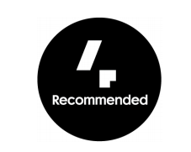

Fund selection process
In addition to external research house rating filters, Salita Portfolio Services conducts their own manager due diligence.
Quality Filter
Role in the Portfolio
Qualitative DD
Quantitative Analysis
Approval
Market exposure
Exposure to market returns either via long-only active management or passive strategies
Value Add
Strategies that are designed to generate strong relative long-term growth or diversification from traditional asset classes
Risk Control
Exposure to strategies that have the ability to manage downside risk. These strategies are designed to act as ‘shock absorbers’ for the portfolio.
External best in class inputs
APL Approval

Slide 16
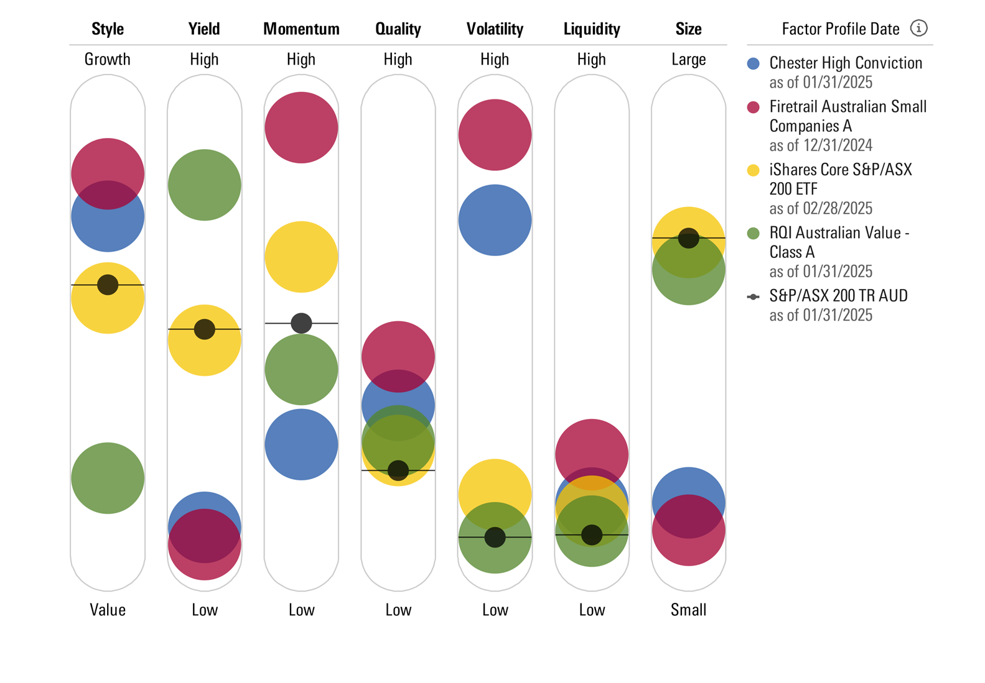
Ongoing Review Process
Salita’s ongoing portfolio review process involves ongoing, identifying risks and opportunities, to continually improve and build resilient portfolios for your clients.
Portfolio Construction
Understand Portfolio Risks
Monitoring Portfolios
Stress Testing
Scenario Analysis
Performance Attribution
For illustrative purposes only.

Slide 17
Ongoing review
Weekly Portfolio Meeting. Standing Agenda:
Recap of manager meetings
Concerns/issues with underlying managers
Performance update and review (post monthly reporting)
Asset allocation thoughts.
Review of floating weights
Adviser Comms
Other business
Monthly meeting with LIS to discuss current AA and macroeconomic views.
Formal attendance by LIS to Salita IC to provide current AA and macroeconomic views.

Slide 18

Our Service offer
03

Slide 19
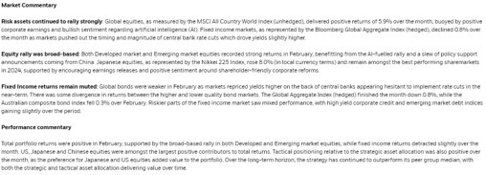
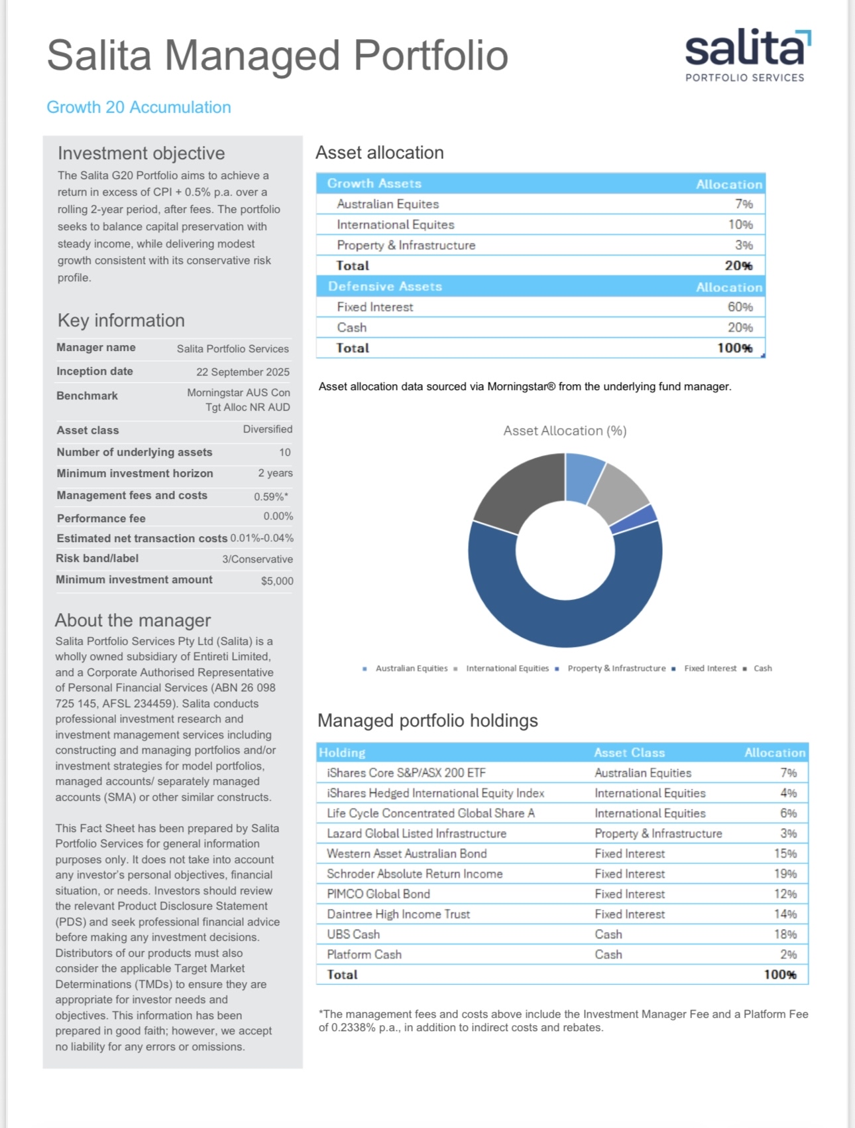
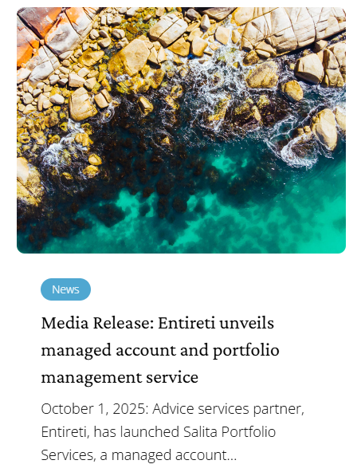
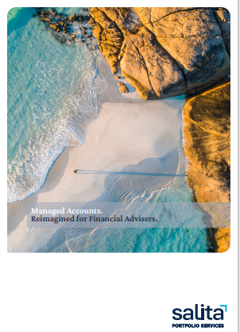
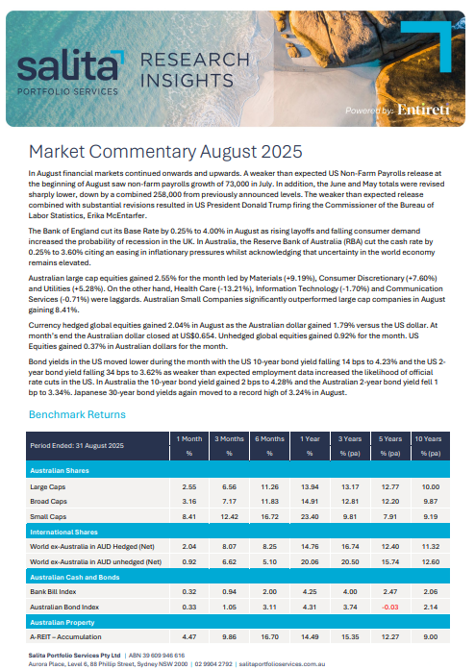
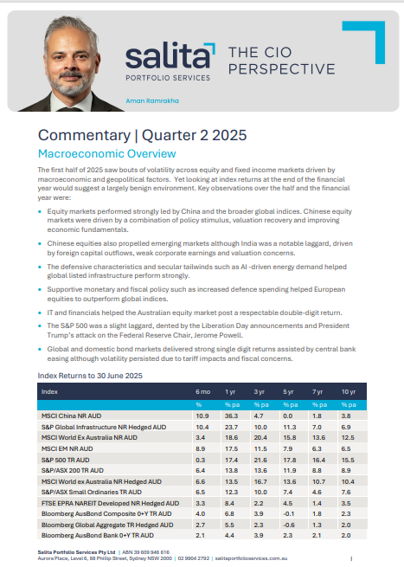
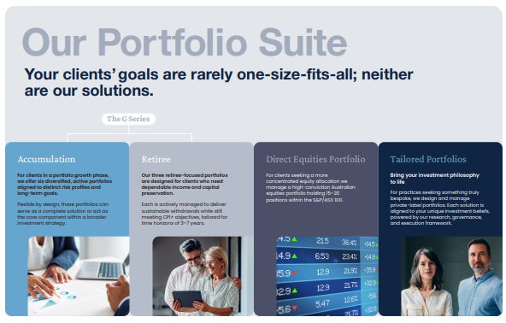
Support & Resources
Direct contact into the team: support@salitaportfolioservices.com.au
Reporting & Tools
PDS & TMDs
Monthly Fact Sheets
Quarterly Reporting
Xplan / Wealthsolver tools
Communications
Fund updates
Market event commentary
Quarterly webinars
Adhoc events
Adviser & Client brochures
Meet the manager sessions
Resources:
Dedicated website: salitaportfolioservices.com.au
- Adviser Guide
- Who is Salita brochure (coming soon)
- Advice preparation guide (AdviserIQ/Member site)
Consulting
Portfolio Solutions support: Tailoring needs, Investment Philosophy, Embedment
Client sessions
Platform training consultants & support

Slide 20

Thank you

